Slide 1
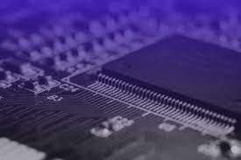
I2C PROTOCOL

Slide 2
CONTENTS
What is communication ?
Classification of communication protocols
I2C Protocol
I2C Interface
Communication parameters
When NACK is generated ?
Modes of I2C
I2C subsystem
API’s
Transfer Data
Read / Receive Data
I2C Mechanisms
Steps to write I2C driver code
Makefile of driver code
Raspberry pi 3 model b+ pin layout
Connection of OLED with raspberry pi 3
Hardware registers and driver code
Output
Errors
Advantages
Disadvantages
Applications
References

Slide 3

What is Communication….?
Communication is the act of giving, receiving, and sharing information.
In other words, communication is sending or receiving the information from one device to another device through some communication protocols.

Slide 4
CLASSIFICATION OF COMMUNICATION PROTOCOLS
Based on Devices communication
Inter system communication
Intra system communication
Based on way of data transfer
Serial communication
Parallel communication
Based on direction of data transfer
Simplex communication
Half Duplex communication
Full Duplex communication
Based on Synchronization
Synchronous communication
Asynchronous communication

Slide 5
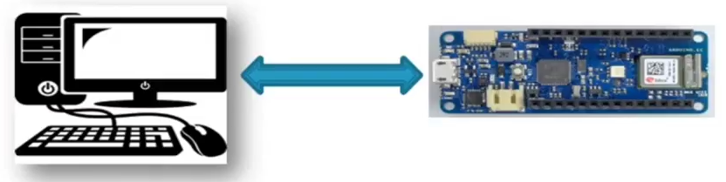
Inter system communication
Communication between two different systems such as PC and microcontroller.
PC
MICRO CONTROLLER
Ex: UART, USB, USART

Slide 6
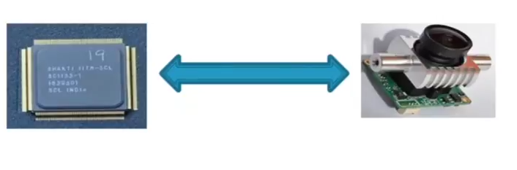
Inter system communication
Communication between two devices within the circuit board.
PROCESSOR
CAMERA MODULE
Ex: I2C, SPI

Slide 7
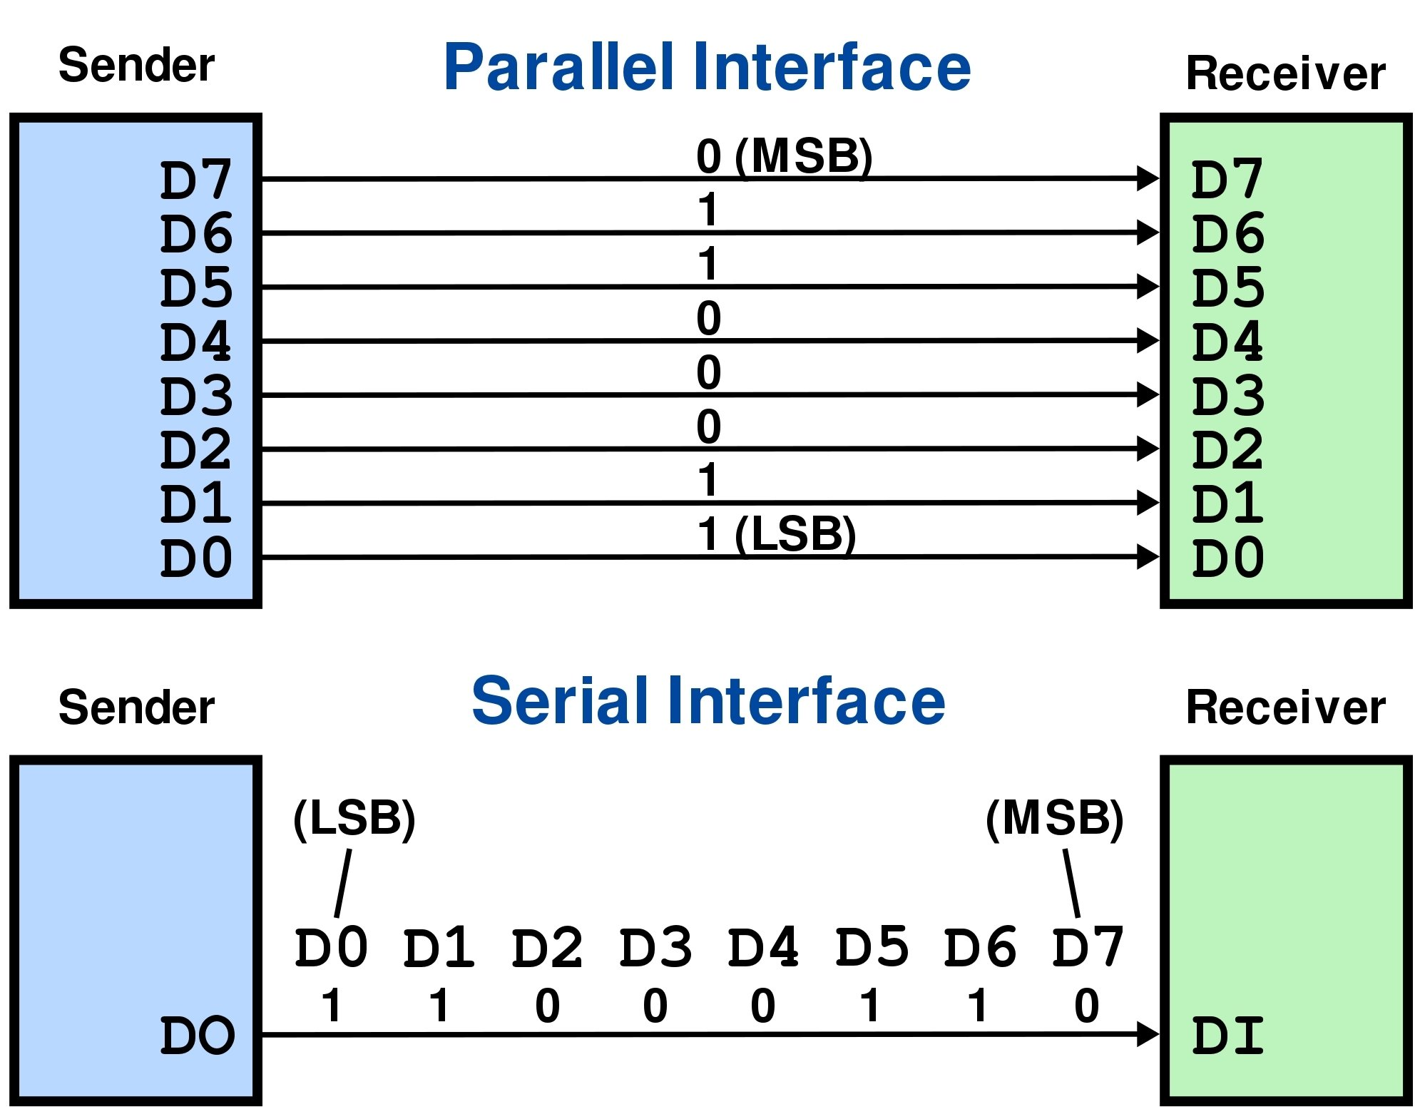
Serial Communication
Data transmission between the devices happens bit by bit in a serial manner.
This requires less number of pins and it is cost efficient.
Serial transmission is slow when compared to parallel transmission.

Slide 8
Parallel Communication
Multiple bits gets transferred simultaneously between the devices.
This requires more number of pins and a bit expensive when compared to serial communication.
Parallel communication is faster.

Slide 9
Communication based on direction of transfer of data
Simplex Communication:
Data transmission happens only in one direction.
Ex: FM Radio.
Half Duplex Communication:
Data transmission is bi-directional but transmission happens in one direction at a time.
Ex: Walkie – Talkie.
Full Duplex Communication:
Data transmission happens in both the directions simultaneously.
Ex: Mobile Phones.

Slide 10
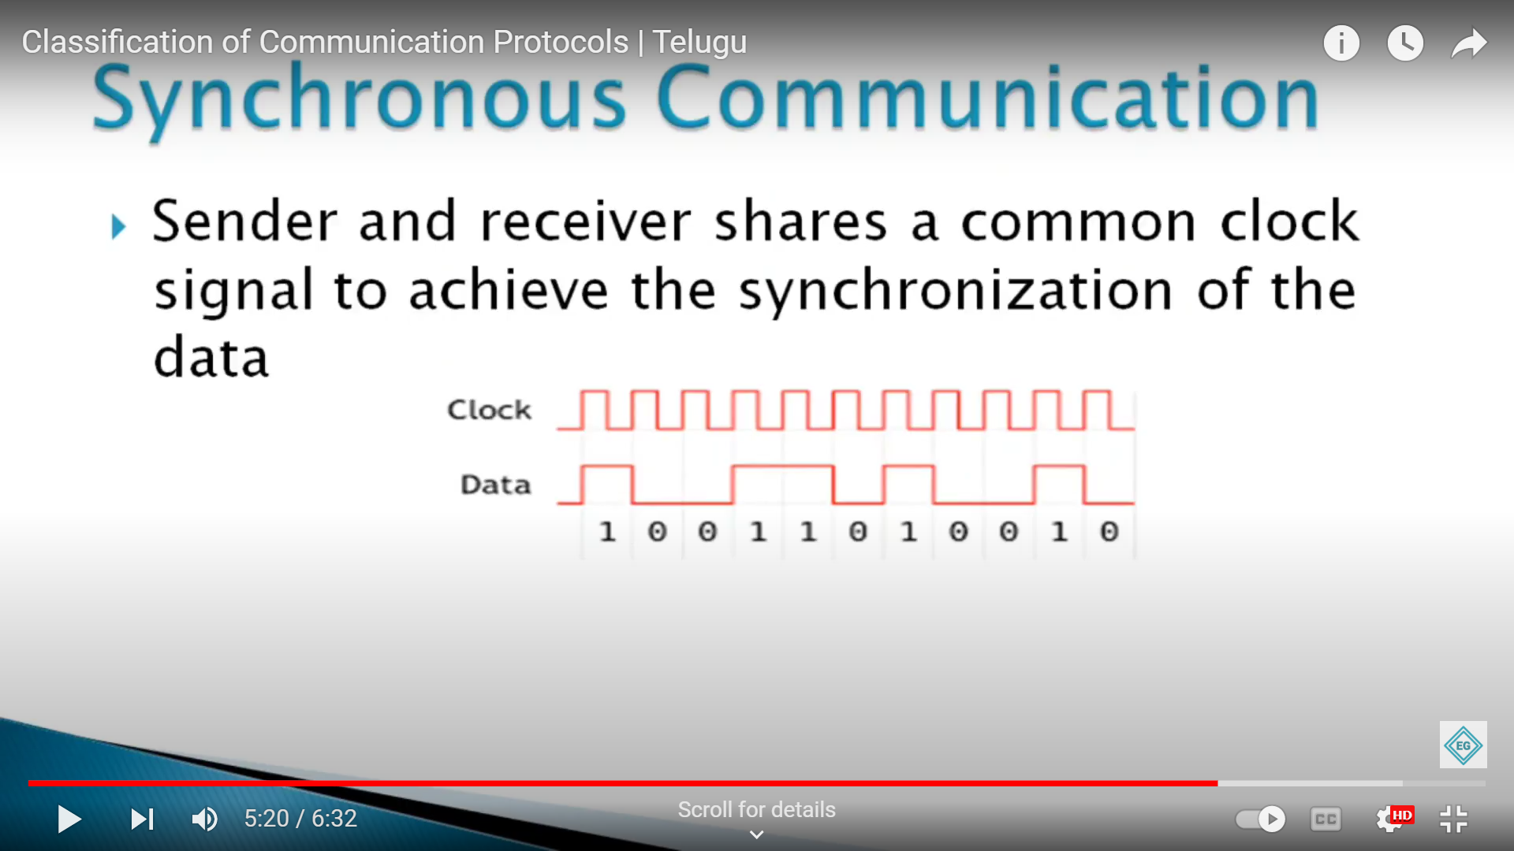
Communication based on Synchronization
Synchronous Communication:
Sender and receiver shares a common clock signal to achieve the synchronization of the data.

Slide 11
Communication based on Synchronization
Asynchronous Communication:
Sender and receiver do not share a common clock signal.

Slide 12
WHAT IS I2C PROTOCOL …..?
PROTOCOL ➔ It is also known as procedure/set of rules which determines how data is transmitted between different devices in same network.
I2C is a serial protocol for a two-wire interface to connect devices like microcontrollers, EEPROMs, A/D and D/A converters, I/O interfaces, and other similar peripherals in embedded systems. It was invented by Phillips (NXP Semiconductors) and now it is used by almost all major IC manufacturers.
It functions as Master-slave communication.
I2C is also known as I squared C or IIC or TWI (Two Wire Interface).

Slide 13
Contd…
The I2C bus is more popular because it is simple to use, there can be more than one master, only upper bus speed is defined and only 2 wires with pull-up resistors are needed to connect with more number of slaves.
I2C can use even slower microcontrollers with general purpose I/O pins since they only need to generate correct start and stop conditions in addition to functions for reading and writing a byte.
Each slave device has a unique address. All these simple requirements make it very simple to implement the I2C interface even with cheap microcontrollers that have no special I2C hardware controller. You only need 2 free I/O pins and few simple i2C routines to send and receive commands.

Slide 14
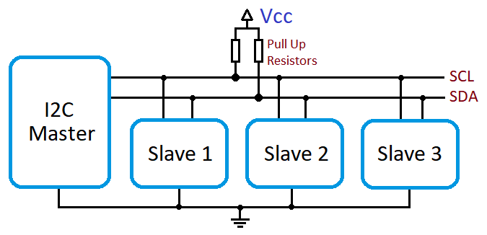
I2C Interface
I2C uses only 2 wires. They are :
Serial Data Line (SDA)
Serial Clock Line (SCL)
Along with each data bit one clock signal is passed on SCL line
The combination of SDA & SCL lines is known as I2C bus. To this I2C bus, SDA & SCL are connected with pull-up resistors.

Slide 15
Contd ….
Slaves on these I2C bus will be in idle/inactive state defaultly.
Each connected slave is identified by 7 bit
or 10 bit address.
Data is read or write by the master or slave
when the clock is high.

Slide 16
COMMUNICATION PARAMETERS
Start condition : The high to low transition on SDA line when clock is in high state. It is used to start the communication
Stop condition : The low to high transition on SDA line when clock is in high state. It is used to stop the communication.
Acknowledgement : Each byte of data (including the address byte) is followed by one ACK bit from the receiver (slave). The ACK bit allows the receiver to communicate to the transmitter that the byte was successfully received and another byte may be sent.
No-Acknowledgement : A NACK after an address is sent means no slave responded to that address. A NACK after write data means the slave either did not recognize the command, or that it cannot accept any more data.
Data bits : It is of 8 bits (1 byte).
Direction bit : It is sent after the 7bit address which determines to read or write
If the direction bit is 1,then it performs read operation.
If the direction bit is 0,then it performs write operation

Slide 17
WHEN NACK IS GENERATED …?
When no slave device is available on the I2C bus with that address , then it will generate NACK.
When master is sending the data to the slave, there is no more memory is available to store the data then the slave will generate NACK.
When master is reading the data from the slave, when master wants to stop reading the data from slave, master will send NACK.
Based on real time scenarios, when slave is busy with some task which is already requested by the master, still the work is not yet completed, slave will generate NACK without responding.

Slide 18
MODES OF I2C
I2C bus specification describes four operating speed categories for bidirectional data transfer:
MODE | SPEED
Standard-mode (Sm) | 100 kbits/sec
Fast-mode (Fm) | 400 kbits/sec
Fast-mode Plus (Fm+) | 1 Mbits/sec
High-speed mode (Hs-mode) | 3.4 Mbits/sec
Ultra-fast mode (UFm) | 5 Mbits/sec (one way communication)

Slide 19
I2C SUBSYSTEM
The kernel divided the I2C subsystem by Buses and Devices. The Buses are again divided into Algorithms and Adapters. The devices are again divided into Drivers and Clients.
I2C
BUSES
DEVICES
ALGORITHM
ADAPTOR
DRIVER
CLIENT

Slide 20
Algorithm:
An Algorithm driver contains a general code that can be used for I2C adapters.
Adapters:
An Adapter effectively represents a bus – it is used to tie up a particular I2C with an algorithm and bus number. Each specific adapter driver either depends on one algorithm driver or includes its own implementation.
Clients:
A Client represents a chip (slave) on the I2C.
Drivers:
This is the driver that we are writing for the client. Usually, Driver and Client are more closely integrated than Algorithm and Adapter.

Slide 21


Slide 22
TRANSFER DATA
Send Data
i2c_master_send( )
This API issue a single I2C message in the master transmit mode.
int i2c_master_send ( const struct i2c_client * client, const char * buf, int count);
Where,
client – Handle to the slave device
buf – Data that will be written to the slave
count – How many bytes to write, must be less than 64k since msg length is u16.
It returns negative errno, or else the number of bytes written.

Slide 23
Contd...
i2c_smbus_write_byte( )
This API is used to send one byte to the slave.
s32 i2c_smbus_write_byte ( const struct i2c_client * client, u8 value);
Where,
client – Handle to the slave device
Value – Byte to be sent
It returning negative errno else zero on success.

Slide 24
Contd...
i2c_smbus_write_byte_data( )
s32 i2c_smbus_write_byte_data ( const struct i2c_client * client, u8 command, u8 value);
Where,
client – Handle to the slave device
command – Byte interpreted by slave
value – Byte being written.
It returning negative errno else zero on success

Slide 25
Contd...
i2c_smbus_write_word_data( )
s32 i2c_smbus_write_word_data ( const struct i2c_client * client, u8 command, u16 value);
Where,
client – Handle to the slave device
command – Byte interpreted by slave
value – 16-bit “word” being written.
It returning negative errno else zero on success.

Slide 26
Contd...
i2c_smbus_write_block_data( )
s32 i2c_smbus_write_block_data ( const struct i2c_client * client, u8 command, u8 length, const u8 * values);
Where,
client – Handle to the slave device
command – Byte interpreted by slave
length – Size of the data block; SMBus allows at most 32 bytes
values – Byte array which will be written
It returns negative errno else zero on success.

Slide 27
READ DATA
i2c_master_recv( )
This API issue a single I2C message in master receive mode.
int i2c_master_recv ( const struct i2c_client * client, const char * buf, int count);
Where,
client – Handle to the slave device
buf – Data that will be read from the slave
count – How many bytes to read, must be less than 64k since msg length is u16
It returns negative errno, or else the number of bytes reads.

Slide 28
Contd...
i2c_smbus_read_byte( )
s32 i2c_smbus_read_byte ( const struct i2c_client * client);
Where,
client – Handle to the slave device.
It is returning negative errno else the byte received from the device.
i2c_smbus_read_byte_data( )
s32 i2c_smbus_read_byte_data ( const struct i2c_client * client, u8 command);
Where,
client – Handle to the slave device
command – Byte interpreted by slave
It is returning negative errno else a data byte received from the device.

Slide 29
Contd...
i2c_smbus_read_word_data( )
s32 i2c_smbus_read_word_data ( const struct i2c_client * client, u8 command);
Where,
client – Handle to the slave device
command – Byte interpreted by slave.
This returns negative errno else a 16-bit unsigned “word” received from the device.
i2c_smbus_read_block_data( )
s32 i2c_smbus_read_block_data ( const struct i2c_client * client, u8 command, u8 * values);
Where,
client – Handle to the slave device
command – Byte interpreted by slave.
values – Byte array into which data will be read; big enough to hold the data returned by the slave. SMBus allows at most 32 bytes.
This returns negative errno else the number of data bytes in the slave’s response.

Slide 30
Contd...
i2c_transfer
If you want to send multiple I2C messages then you can use the below-given API.
int i2c_transfer ( struct i2c_adapter * adap, struct i2c_msg * msgs, int num);
Where,
adap – Handle to the I2C bus
msgs – One or more messages to execute before STOP is issued to terminate the operation; each message begins with a START.
num – Number of messages to be executed.
It returns negative errno, else the number of messages executed.

Slide 31
I2C MECHANISMS
Synchronization
Each master must generate its own clock signal and the data can change only when the clock is low. For successful bus arbitration, a synchronized clock is needed. Once a master pulls the clock low it stays low until all masters put the clock into a high state. Similarly, the clock is in a high state until the first master pulls it low. This way by observing the SCL signal, master devices can synchronize their clocks.
Clock Stretching
The master device determines the clock speed. However, there are situations where an I2C slave is not able to co-operate with the clock speed given by the master and needs to slow down a little. This is done by a mechanism called Clock Stretching. An I2C slave is allowed to hold down the clock if it needs to reduce the bus speed. The master, on the other hand, is required to read back the clock signal after releasing it to the high state and wait until the line has actually gone high.

Slide 32
Contd…
Arbitration
For normal data transfer on the I2C bus, only one master can be active. If for some reason two masters initiate the I2C command at the same time, the arbitration procedure determines which master wins and can continue with the command. Arbitration is performed on the SDA signal while the SCL signal is high. Each master checks if the SDA signal on the bus corresponds to the generated SDA signal. If the SDA signal on the bus is low but it should be high, then this master has lost arbitration. Master I2C device that has lost arbitration can generate SCL pulses until the byte ends and must then release the bus and go into slave mode. The arbitration procedure can continue until all the data is transferred. This means that in a multi-master system each I2C master must monitor the I2C bus for collisions and act accordingly.

Slide 33
Differences between I2C and SMBus
In general, the I2C bus and SMBus are compatible, but there are some subtle differences between the two that can cause some problems. The following tables summarize the differences between the two buses.
Clock speed comparison
Bus | I2C | SMBus
Minimum | None | 10 KHz
Maximum | 100 KHz (Standard Mode) 400 KHz (Fast Mode) | 100 KHz
Timeout | None | 35 ms

Slide 34
Contd…
Electrical Characteristics Comparison
Bus | I2C | SMBus
VHigh | Fixed Voltage: 3.0 to VDD_max + 0.5V VDD Relative: 0.7 to VDD_max + 0.5V | 2.1 V to VDD
VLow | Fixed Voltage: -0.5V to 1.5V VDD Relative: -0.5 to 0.3VDD | to 0.8 V
Max Current | 3 mA | 350 µA

Slide 35
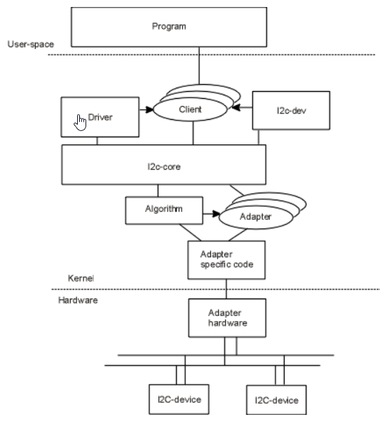
I2C SUBSYSTEM

Slide 36
STEPS TO WRITE I2C DRIVER CODE
1.Get the i2c adapter.
2.Create board info structure and create a device using that.
3.Create device id for your slave and register that.
4.Create i2c driver structure and add that to the i2c subsystem.
5.Start the communication.

Slide 37
Get the adapter
In the raspberrypi i2c1 bus is already available. You can check that using the command ls –al /sys/bus/i2c/devices/ . So we will below Api to get the adapter structure of this i2c bus.
Struct i2c_adapter * i2c_get_adapter(int nr);
where ,
nr-I2C number generally we use 1.
It returns the struct i2c_adapter.

Slide 38
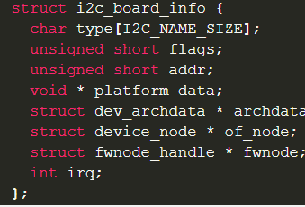
Create board info
Once you get the adapter structure, then create the board info and using that board info, create the device.
Just create the board info structure and assign required members.

Slide 39
where,
type[I2C_NAME_SIZE] – chip type, to initialize i2c_client.name flags – to initialize i2c_client.flags addr – stored in i2c_client.addr platform_data – stored in i2c_client.dev.platform_data archdata – copied into i2c_client.dev.archdata of_node – pointer to OpenFirmware device node fwnode – device node supplied by the platform firmware irq – stored in i2c_client.irq
You can use I2C_BOARD_INFO macro to initialize the essential fields of struct i2c_board_info.

Slide 40
I2C_BOARD_INFO ( dev_type, dev_addr);
where,
dev_type – identifies the device type
dev_addr – the device’s address on the bus
Create Device
struct i2c_client * i2c_new_device ( struct i2c_adapter * adap, struct i2c_board_info const * info);
where,
*adap – Adapter structure that we got from i2c_get_adapter()
*info – Board info structure that we have created
This will return the i2c_client structure.

Slide 41
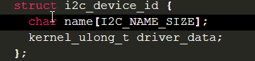
If you are using the newer kernel (5.2 =<), then you must use the i2c_new_client_device API instead of i2c_new_device.
Create the device id and register
Now we have to create the i2c driver for our slave. In order to do that, you have to create the device id and i2c_driver. Then add that driver to the I2C subsystem.
Just create the structure i2c_device_id and initialize the necessary members.
where,
name – Slave name driver_data – Data private to the driver (This data will be passed to the respective driver)
After this, call MODULE_DEVICE_TABLE(i2c, my_id_table) in order to expose the driver along with its I2C device table IDs to user space.

Slide 42
Create i2c driver
struct i2c_driver {
unsigned int class;
int (* attach_adapter) (struct i2c_adapter *);
int (* probe) (struct i2c_client *, const struct i2c_device_id *);
int (* remove) (struct i2c_client *);
void (* shutdown) (struct i2c_client *);
void (* alert) (struct i2c_client *, unsigned int data);
int (* command) (struct i2c_client *client, unsigned int cmd, void *arg);
struct device_driver driver;
const struct i2c_device_id * id_table;
int (* detect) (struct i2c_client *, struct i2c_board_info *);
const unsigned short * address_list;
struct list_head clients;
};

Slide 43
Where,
class – What kind of i2c device we instantiate (for detect) attach_adapter – Callback for bus addition (deprecated) probe – Callback for device binding remove – Callback for device unbinding shutdown – Callback for device shutdown alert – Alert callback, for example for the SMBus alert protocol command – Callback for bus-wide signaling (optional) driver – Device driver model driver id_table – List of I2C devices supported by this driver detect – Callback for device detection address_list – The I2C addresses to probe (for detect) clients – List of detected clients we created (for i2c-core use only)

Slide 44
ADD THE I2C DRIVER TO THE I2C SUBSYSTEM
Now we have the i2c_driver structure. So we can add this structure to the I2C subsystem using the below API.
During the call to i2c_add_driver to register the I2C driver, all the I2C devices will be traversed. Once matched, the probe function of the driver will be executed.
You can remove the driver using i2c_del_driver(struct i2c_driver *i2c_drive).
i2c_add_driver(struct i2c_driver *i2c_drive); Where, i2c_drive – The i2c_driver structure that we have created.

Slide 45
Make File
obj-m += driver1.o KDIR = /lib/modules/$(shell uname -r)/build all: make -C $(KDIR) M=$(shell pwd) modules clean: make -C $(KDIR) M=$(shell pwd) clean

Slide 46
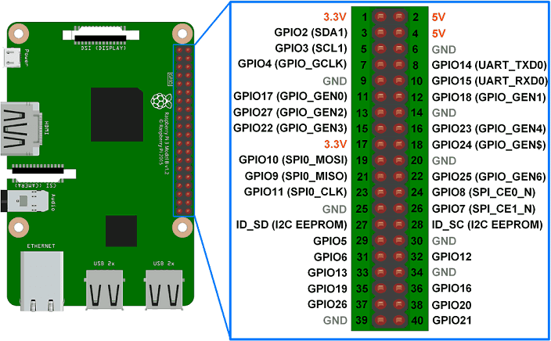
RASPBERRY PI 3 MODEL B+ PIN LAYOUT

Slide 47
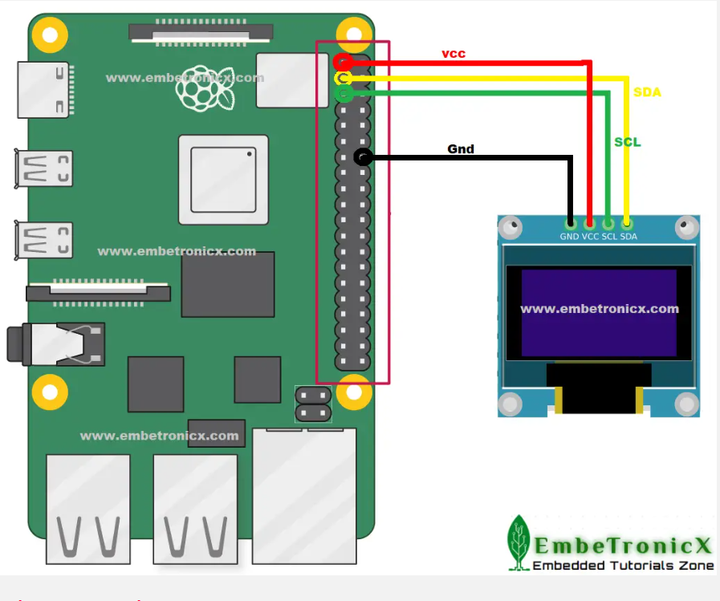
CONNECTION OF OLED WITH RASPBERRY PI 3

Slide 48
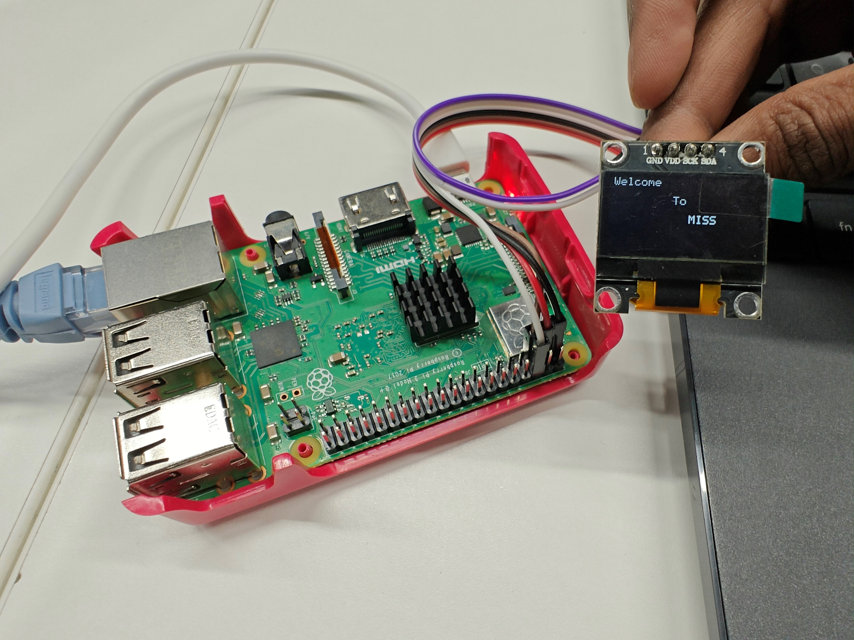
OUTPUT

Slide 49
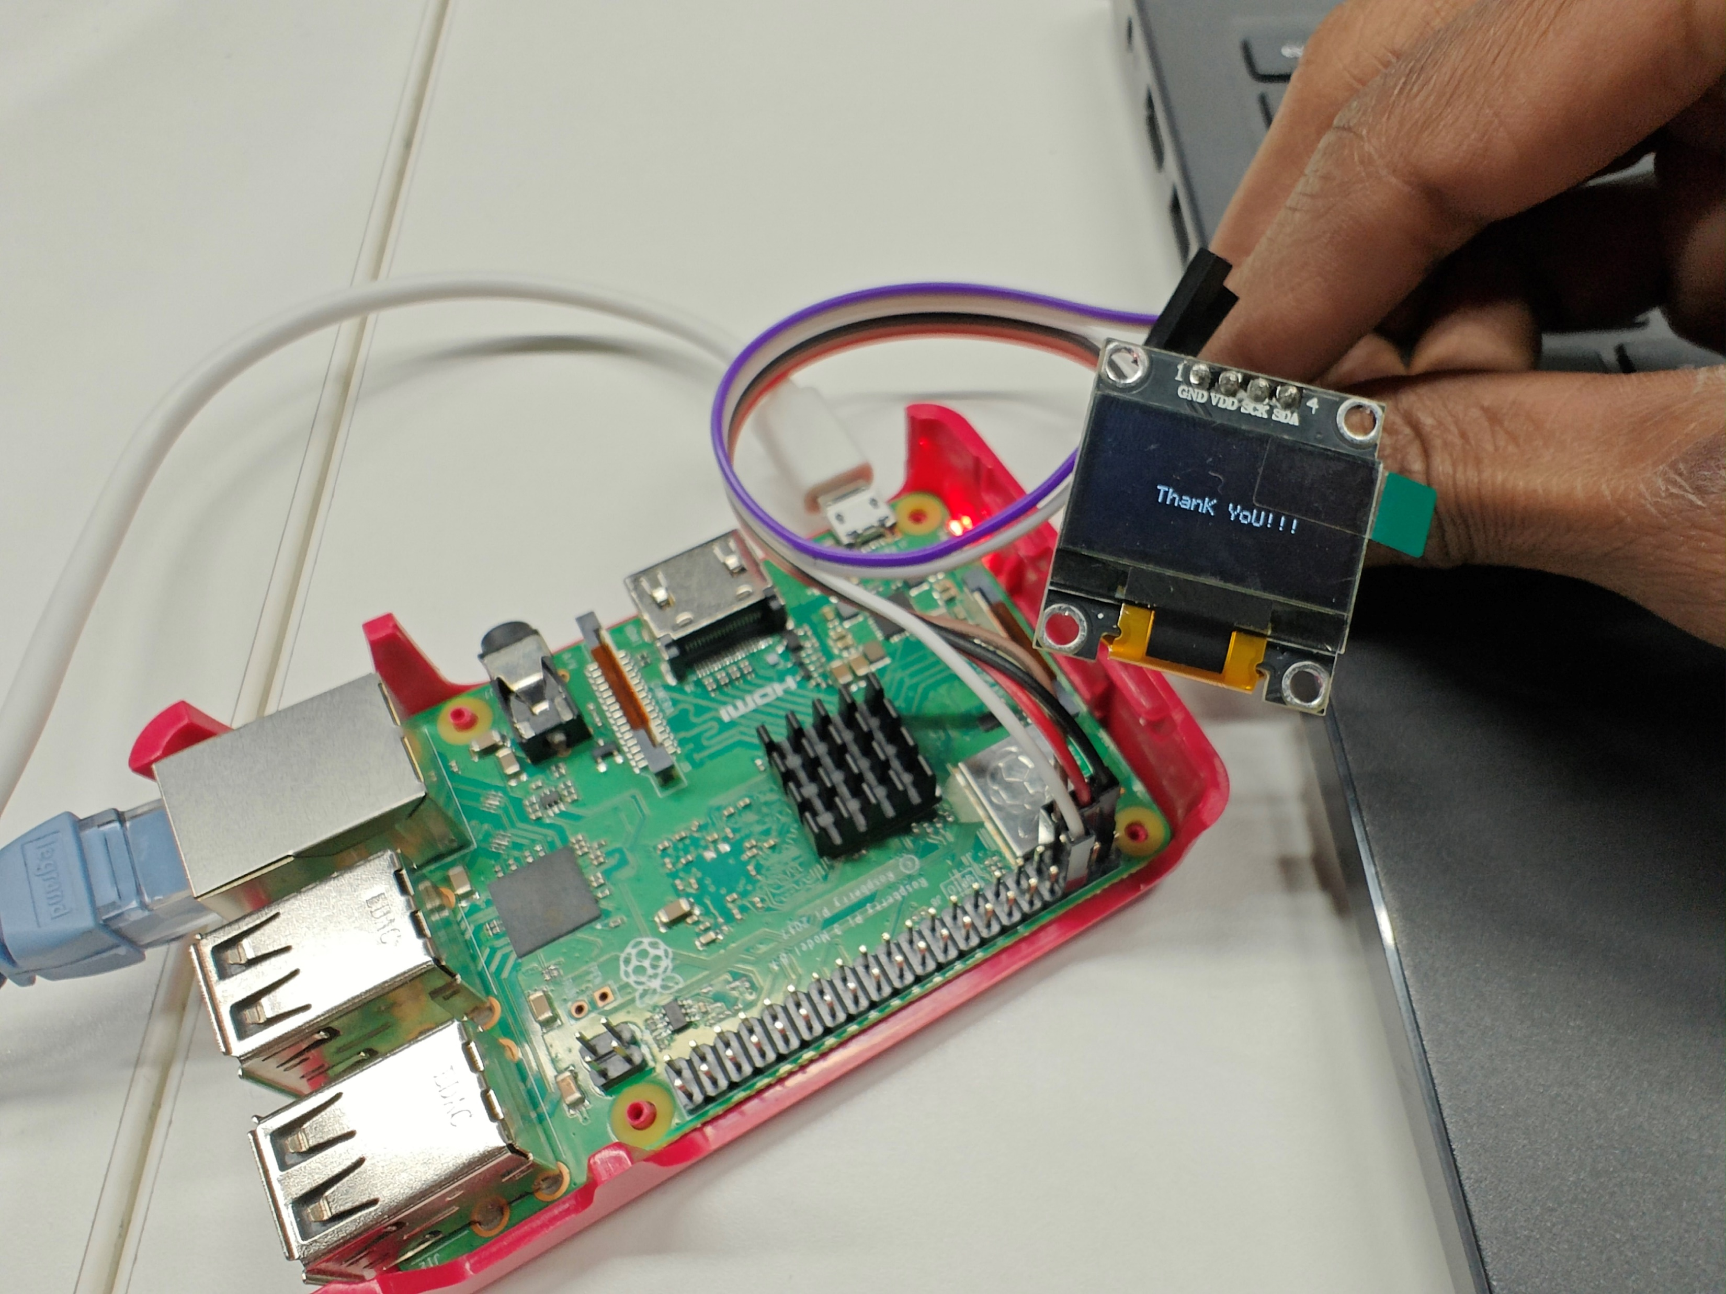
OUTPUT

Slide 50
ERRORS
Not Enabled (-13)
This is a straightforward error that is issued when you have attempted to access an imp I²C bus that has not yet been configured. Check your code and, if necessary, call i2c.configure() with a supported speed constant passed as a parameter.
Controller Select Error (-1)
The imp signals its intention to begin an I²C transaction by establishing the standard I²C start condition: it attempts to pull the SDA line low (so the waveform has a falling edge) while the SCL line remains high. If the imp is unable to pull SDA low, this error will be issued.
This error may arise if another I²C master is operating on the same bus and has taken control of it. If the imp is the only master on the bus, this error may result from poorly chosen pull-up resistors. I²C ports are open drain so can only pull the SDA and SCL lines low; pull-up resistors are required to drive the lines high when they are released by bus devices.

Slide 51
ERRORS
Transmit Select Error (-2)
After the imp has signalled start and is ready to write data to it, it sends the 7-bit address of the I²C peripheral it wants to communicate with, followed by a single bit indicating whether the transaction is a write (the imp pulls SDA low) or a read (the imp leaves SDA high). These eight bits should be acknowledged by a single-bit ACK signal from the peripheral at the transmitted address; it pulls SDA low. If the acknowledgement doesn’t occur during the ninth clock pulse, then the imp will issue this error.
If this error is encountered, check the value of the peripheral’s address that you are passing. Some devices have multiple addresses, selectable by setting an address pin to one of three states (high, low or floating). The imp API takes addresses in 8-bit form; 7-bit addresses will need to be bit-shifted left one place.
Transmit Error (-3) BTF Error (-4)
Once the peripheral has acknowledged its readiness, the imp can begin to send the data it wants to write. Data is sent byte by byte, each one written to the imp’s data register from which it is passed to a shift register and from there out onto the bus one bit at a time. Once the peripheral has clocked in a byte of data, it should acknowledged receipt. If it fails to do so while the imp is processing any byte of the data but the last, a transmit error will be issued. If the error occurs sending the last byte, a BTF error is reported instead.
A transmit error may also be reported if the bit value clocked out is not seen on the bus, ie. the imp sends a 1, i.e., it leaves the SDA line high, but the SDA line is pulled low. This could indicate bus contention — there is another master on the bus — or, more likely, that the I²C circuit’s pull-up resistors are too weak to keep the lines high.

Slide 52
ERRORS
Stop Error (-5)
Once the imp has successfully written all the data it wants to send to the peripheral (or read back all the data that it requested), it signals the completion of the transaction with a stop condition: while SCL is high, SDA is released to go high too (the waveform has a rising edge). This releases the bus for other devices to make use of it. Again, the imp checks that this stop signal has been sent correctly. If it has not, then this error will be issued.
Address Clear Error (-6)
During a read operation, the imp places on the bus the I²C address of the peripheral it wants to read data from. This event should be acknowledged by the peripheral. If it is not, the imp will return this error.

Slide 53
ERRORS
Reselect Error (-12)
If the imp wishes to read data from a specific peripheral register, it must first write that register’s address to the peripheral as a data value. After the register address has successfully been written, the imp initiates a read operation, to pick up the value the peripheral returns from the register. The imp switches from write mode to read mode by issuing a second start signal. Once again, it checks that it can proceed. If it is unable to do so within the timeout period, this error will be issued.
Address RXNE Error (-7) Data RXNE Error (-8) Controller Receive Select Error (-10) Receive Error (-11) BTF Receive Error (-14)
All of these errors indicate a failure to read a byte from the peripheral at some point during the read operation. This is often caused by the peripheral holding the SCL line low while it retrieves the requested byte(s) — a technique called ‘clock stretching’.
Which error you get will depend on the number of bytes you have requested to be read and on the exact point where the receive error occurred.

Slide 54
ADVANTAGES
More than one master devices can be used in the circuit.
I2C requires only two wires for communication unlike SPI which requires four. Hence it minimizes interconnections between ICs due to fewer pins and also fewer PCB tracks. This results into smaller and less expensive PCBs.
The addressing is very simple and does not need any CS lines to add extra devices like SPI. Hence addition of any extra device is very easy.
It uses open collector bus design and hence there is flexibility to use voltage on the bus. Moreover slew rates are limited.
It uses flow control.
It is easy to perform diagnosis and debugging. Hence it is easy to trace malfunctionalities.
ICs can be added or removed from the hardware without affecting any other circuits on bus.

Slide 55
DISADVANTAGES
Conflicts – Due to chip addressing, there's always a possibility of an address conflict.
Slower speeds – I2C protocol uses pull-up resistors rather than the push-pull ones used by its peers. ...
Requires more space – Now, as an embedded system engineer, you know how valuable PCB real estate is.
APPLICATIONS
I2C is a suitable protocol for connecting short-distanced, low-speed peripherals on printed circuit boards (PCBs). Common I2C applications can include reading memory, reading hardware sensors, and accessing DACs and ADCs.

Slide 56
REFERENCES
https://developer.electricimp.com/resources/i2cerrors
https://www.rfwireless-world.com/Terminology/Advantages-and-Disadvantages-of-I2C.html
https://embetronicx.com/
https://www.researchgate.net/figure/Raspberry-Pi-GPIO-Pin-Diagram_fig9_339473182
https://cs140e.sergio.bz/docs/BCM2837-ARM-Peripherals.pdf
https://cdn-shop.adafruit.com/datasheets/SSD1306.pdf
https://i2c.wiki.kernel.org/index.php/Driver_Architecture

Slide 57
THANK YOU

